Slide 1
Anticipating Credit Card Churn (Attrition)
Credit Card Churn Reduction Analysis
Reed Iredale — January 2022

Slide 2
Situation Appraisal
Giving Business Context Before Diving into the Data
Macquarie Bank’s Credit Card Manager is uncomfortable with more and more customers leaving their overall credit card service. They would really appreciate it if someone could predict who will be affected so that they can proactively go to the customer to provide them with better services and turn customer decisions in the opposite direction.

Slide 3
Can We Anticipate Churn?
Business Question
Can We Anticipate Churn on Macquarie Credit Cards?

Slide 4
Data Summary
10,000 Rows, 23 Features (Features of Use Below)
Attrition Flag (Attrited aka Churned or Not): This is our target variable, means whether our customer decided to leave the organisation or that there is a high probability the customer will leave.
Gender: Male or Female
Customer Age: Age of the customer
Income Category (4 Categories): To which income category does the customer belongs to.
Card Category (4 Cards): Which card category does the customer have?
Months Inactive: Amount of inactivity when using the credit card.
Credit Limit: Credit Limit the customer currently has.
Total Revolving Balance: The unpaid portion that carries over to the next month when a customer does not pay.
Average Utilisation Ratio: Measures how much credit you are using compared to how much you have available.
Open to Buy: The amount of credit available at a given time on a credit card holders account. Thus, the average open to buy is the average credit available allocated to a specific customer.

Slide 5
Data Pipeline
The Data Process to Better Decision-Making
Define
Objectives
Metrics
Value
Prepare
Wrangle
Clean
Profile
Munge
Analyse
Model
Predict
Revise
Evaluate
Deliver
Visualise
Summarise
Advise
Deploy

Slide 6
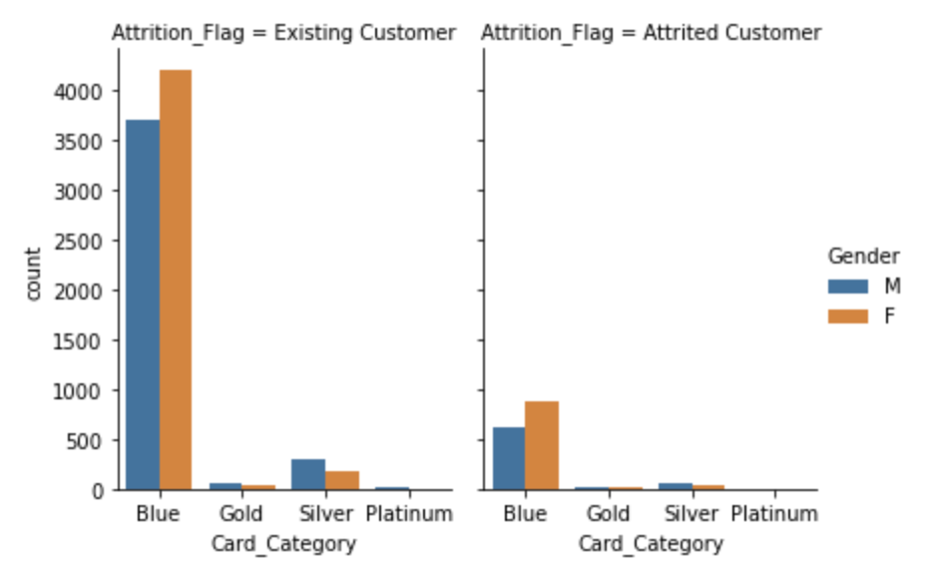
Exploratory Data Analysis
Attrition, Gender and the Card Type

Slide 7
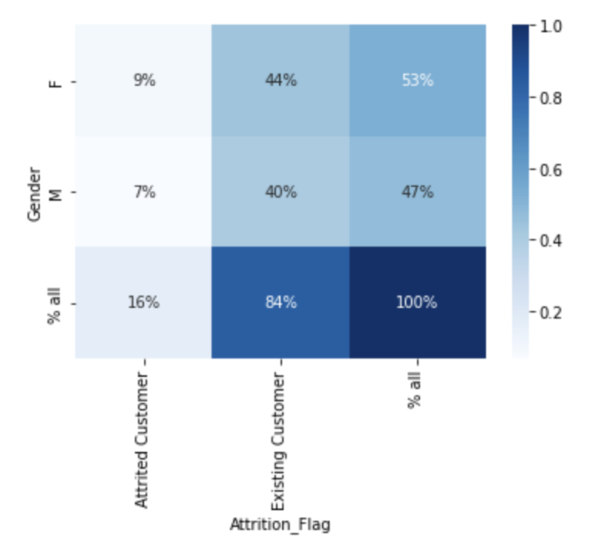
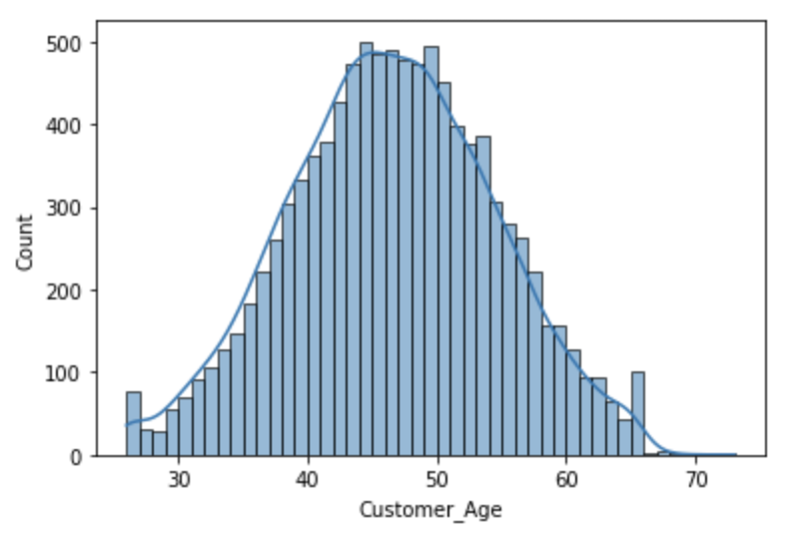
Exploratory Data Analysis
Gender Attrition and Customer Age Buckets

Slide 8
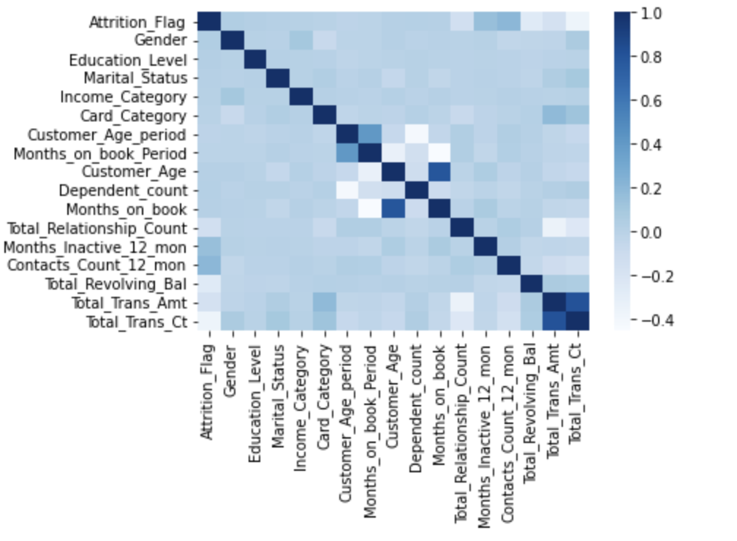
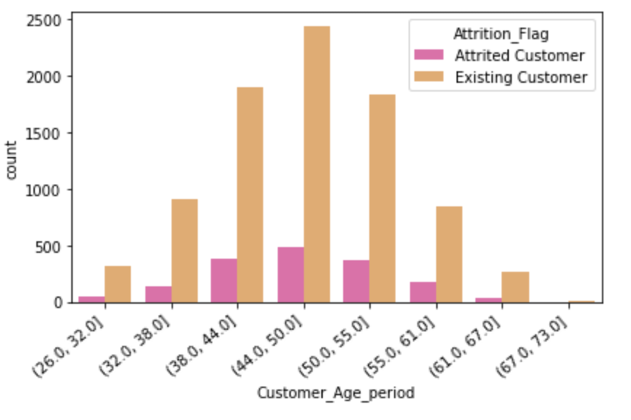
Exploratory Data Analysis
Correlation and Custom Age Attrition

Slide 9
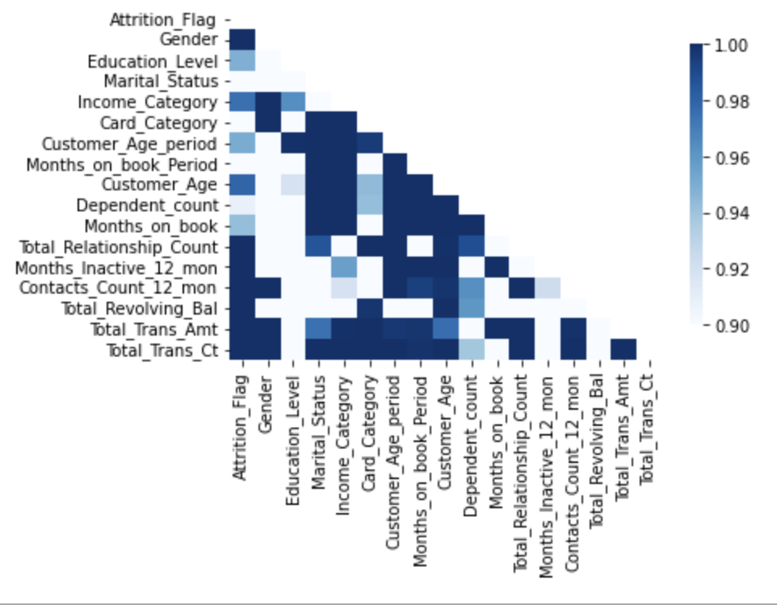
Exploratory Data Analysis
P-Value

Slide 10
Hypothesis Testing
Hypothesis Testing Gives Clarity On Findings
Question: Is ‘Attrition Age’ causing most churn?
H0: No initial correlation.
H1: However, when I researched other ways (chi2) to compute p-value other features are dependent on the target.
New question #1: Are price tiers defined correctly?
New question #2: Can we improve customer experience when inactivity is low?

Slide 11
Next Steps
What Decision-Making Steps Can We Take?
Key focus on reducing churn for customers 44-50 year olds
Focus on improving price tiers to move customers into higher and more premium products, aligned with their income
Act when activity is low
Increase credit card limits to those with lower revolving balance

